Slide 1


Slide 2



LEARNING OUTCOMES
Understanding the definition and nature of Motivation.
Types of motivation
Theories of motivation

Slide 3

MOTIVATION
Many people know motivation as a driving force /Reasoning behind an action.
The term ‘motivation’ is derived from the word ‘motive ’.
Motive may be defined as needs, wants, drives within the individual

Slide 4
A motivation is a condition that energizes behavior and gives it direction.
Motivation is the process that initiates, guides, and maintains goal-oriented behaviors. It is what causes you to act, whether it is getting a glass of water (goal) to reduce thirst (drive) or reading a book to gain knowledge.
Notes:
Drive Leading to Goal-Directed Behavior: Drive refers to the internal state that pushes an individual to fulfill certain needs or desires. This drive can propel individuals towards engaging in goal-directed behavior. For example, if someone experiences hunger (drive), they may engage in the goal-directed behavior of seeking food.
Goal-Directed Behavior Fueling Drive: Conversely, engaging in goal-directed behavior can also influence one's drive or motivation. When individuals set and achieve goals, it can lead to feelings of accomplishment, satisfaction, and even a surge in motivation to pursue further goals. Success in achieving goals can reinforce the drive to pursue similar objectives in the future.

Slide 5

NATURE OF MOTIVATION
Based on motives
Goal directed behavior
Related to satisfaction

Slide 6

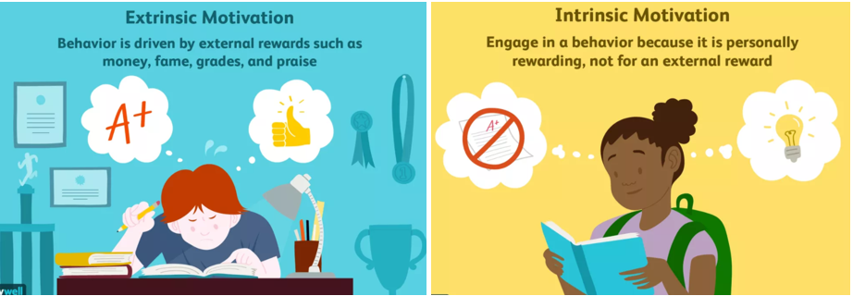
TYPES OF MOTIVATION
  Extrinsic motivations is reward-driven behavior. A desire to perform a behavior to obtain an external reward or avoid punishment
Examples are:
competing in sports for trophies.
completing work for money.
customer loyalty discounts.
buy one, get one free sales.
Helping other because you hope for praise.

Slide 7
2. Intrinsic motivations: are those that arise from within the individual OR
  A desire to perform a behavior originates within the individual
  For example:
  Doing a complicated cross-word puzzle purely for the personal gratification of solving a problem.
  Learning new language because you like experiencing new things.
  Taking on more responsibility at work because you enjoy being challenged & feeling accomplished.

Slide 8
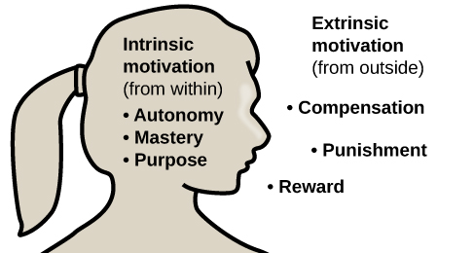

Slide 9
Motivation is a complex phenomenon influenced by various factors.
However, three key components that are often identified in motivational theories are,

Slide 10
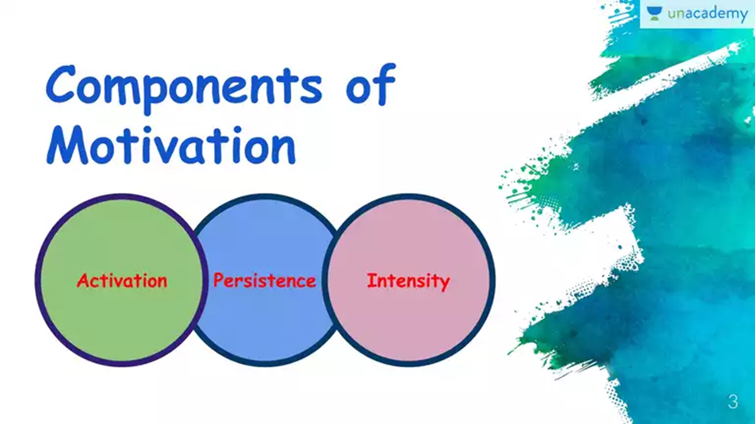

Slide 11
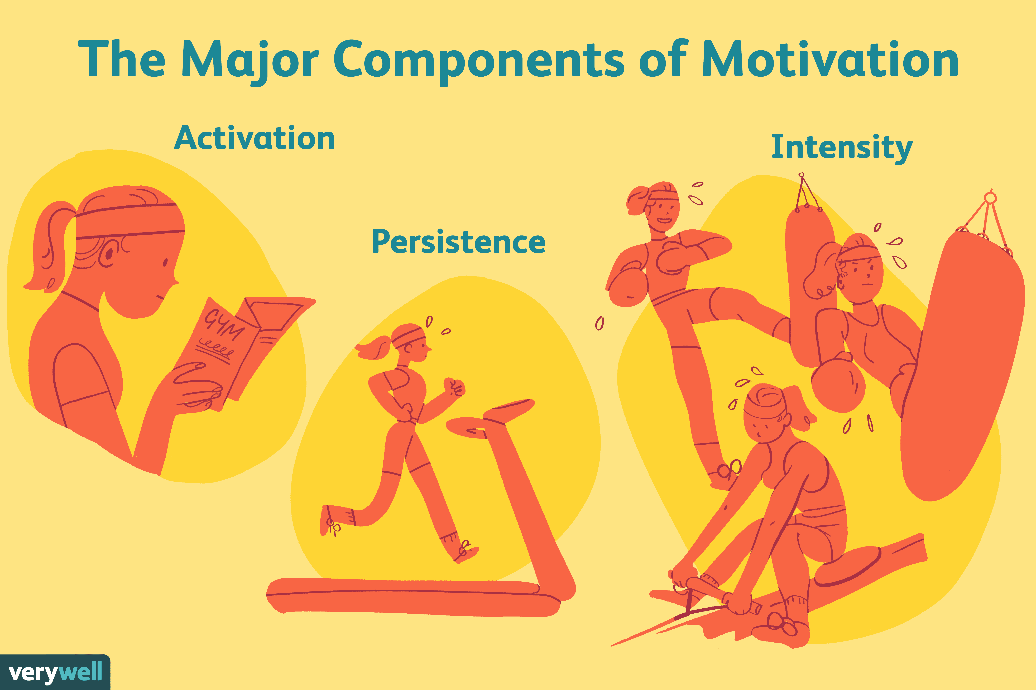
Arnold et al (1991): How individuals engage in goal-directed behavior.
Activation: refers to the initiation or start of a behavior. It involves the decision to begin a specific task or activity. It involves the arousal of enthusiasm, interest, or excitement towards achieving a desired outcome.
Example: A student becoming interested in biology after a captivating class discussion on genetics.
Or
A student deciding to start working on a challenging assignment rather than procrastinating

Slide 12

2. Persistence: it is the sustained effort and determination to continue a behavior or activity over time, despite obstacles, setbacks, or difficulties. High levels of persistence are often associated with strong motivation.
Example: An athlete continuing to train regularly even when faced with injuries or decline in performance

Slide 13
3. Intensity: is the level of effort and concentration an individual puts into a task or activity.
It reflects the degree of energy invested in pursuing a goal.
Example: An entrepreneur investing long hours and intense focus into launching a new business venture driven by passion and determination.

Slide 14
THEORIES OF MOTIVATION
Drive Reduction Theories
Humanistic theories

Slide 15
DRIVE REDUCTION THEORY
Developed by Clark L. Hull, the Drive-Reduction Theory states that the reduction of drives is the primary force behind motivation.
when an organism has a need (such as hunger), the need leads to psychological tension that motivates the organism to act, fulfilling the needs and reducing the tension.
Example:
When we're cold, we put on a sweater to address our need for warmth and maintain our body temperature.

Slide 16
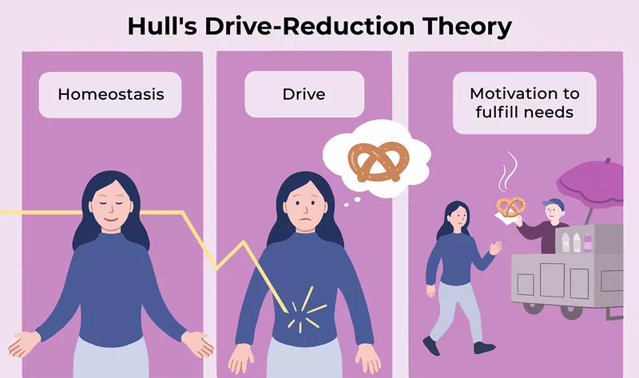

Slide 17
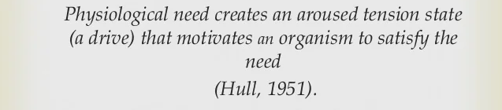

Slide 18
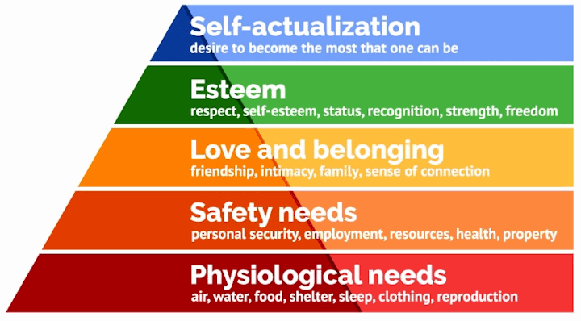
Humanistic Theory –
Maslow’s Hierarchy of needs:
Maslow’s model places motivational needs in a hierarchy and suggests that before more sophisticated, higher-order needs can be met, certain primary needs must be satisfied

Slide 19
The basic needs are primary drives: needs for water, food, sleep etc.
To move up the hierarchy, a person must first meet these basic physiological needs.
Safety needs come next in the hierarchy; Maslow suggests that people need a safe, secure environment in order to function effectively. Physiological and safety needs compose the lower-order needs.

Slide 20
Only after meeting the basic lower-order needs can a person consider fulfilling Higher order needs, such as the needs for love and a sense of belonging, esteem, and self-actualization.
Love and belongingness needs include the needs to obtain and give affection and to be a contributing member of some group or society.
After fulfilling these needs, a person strives for esteem.

Slide 21
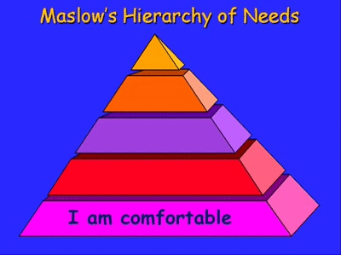
In Maslow’s thinking, esteem relates to the need to develop a sense of self-worth by recognizing that others know and value one’s competence.
Once these four sets of needs are fulfilled—no easy task—a person is able to strive for the highest-level need, self-actualization.
Self-actualization is a state of self-fulfillment in
which people realize their highest potentials in their
own unique way.

Slide 22

Tips For Finding Motivation
Adjust your goals to focus on things that really matter to you
If you're tackling something that is just too big or too overwhelming, break it up into smaller steps and try setting your sights on achieving that first step toward progress
Remind yourself about what you achieved in the past and what/ where your strengths lie
If there are things you feel insecure about, try working on making improvements in those areas so that you feel more skilled and capable.

Slide 23

Notes:
https://www.carepatron.com/files/motivational-worksheet.pdf
https://www.teacherspayteachers.com/Product/Theatre-I-IV-Motivation-Behavior-Worksheet-5686283

Slide 24
Worksheets for motivation
https://www.carepatron.com/files/motivational-worksheet.pdf
https://www.teacherspayteachers.com/Product/Theatre-I-IV-Motivation-Behavior-Worksheet-5686283

